Slide 1


Nonparametric Self-Exciting Point Processes: Benefits and Uses
James Molyneux
Assistant Professor
Department of Statistics
Slides: https://github.com/jimmylovestea/wnar-2021-slides
: jimmylovestea
: @jimmylovestea

Slide 2

Outline
Self-exciting phenomenon
Self-exciting point processes
Recent nonparametric innovations
Application: Hector Mine earthquake sequence
Closing thoughts
2

Slide 3
Self-exciting phenomenon

Slide 4
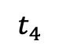
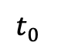

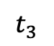
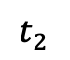
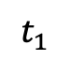
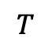
Self-exciting phenomenon
Time:
$$t_{0}$$
$$t_{1}$$
$$t_{2}$$
$$t_{3}$$
$$t_{4}$$
$$⋯$$
$$T$$
4

Slide 5
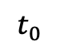
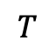
Self-exciting phenomenon
Time:
$$t_{0}$$
$$T$$
5

Slide 6
Self-exciting phenomenon
Time:
$$t_{0}$$
$$T$$
6
Notes:
Points are clustered in time and space

Slide 7
Self-exciting phenomenon
Invasive Species (Balderama, 2012)
Invasive species introduced by animals, floods, winds, people, etc.
Reproduce and spread
Crime (Mohler, 2011)
Successful burglary occurs in a neighborhood
Successive burglaries attempted nearby
Disease Epidemics (Park, 2020; Bertozzi, 2020)
A person is infected with a disease
The disease spreads from person to person
Earthquakes (Ogata, 1999)
Mainshock earthquake occurs
Aftershocks occur afterwards
7

Slide 8
Self-exciting point processes

Slide 9
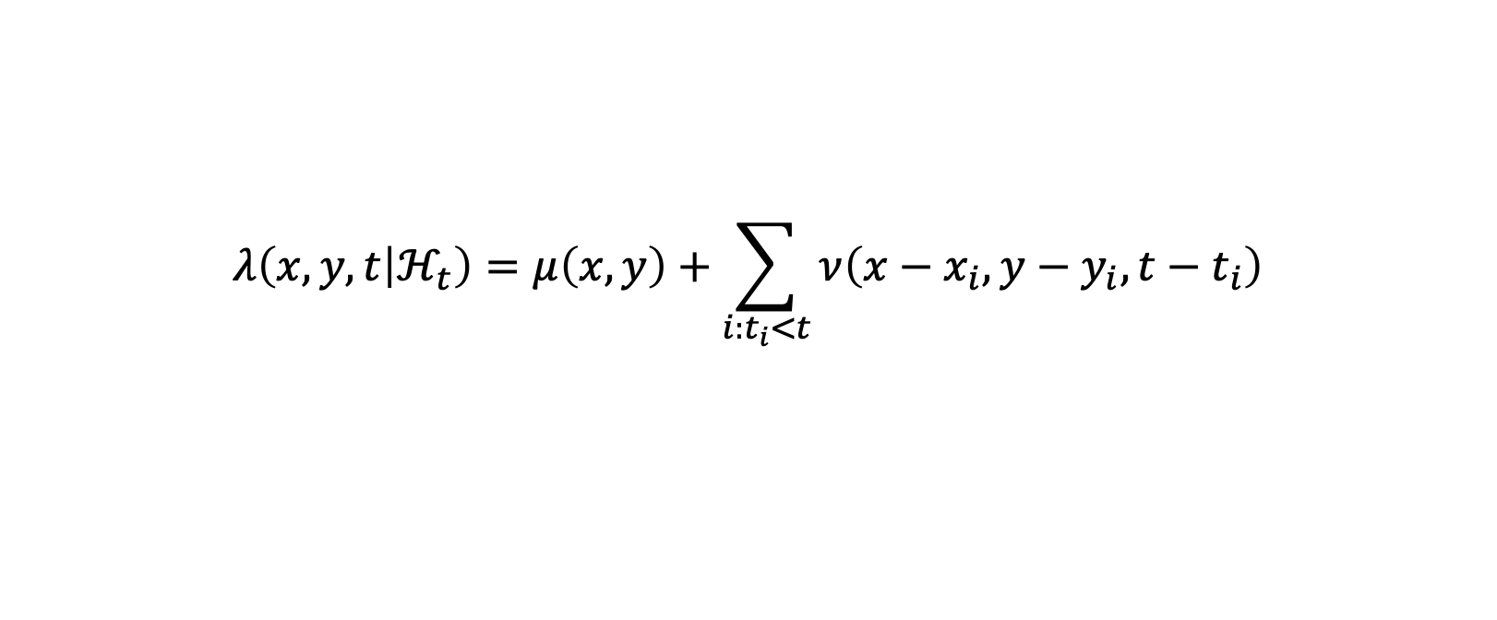
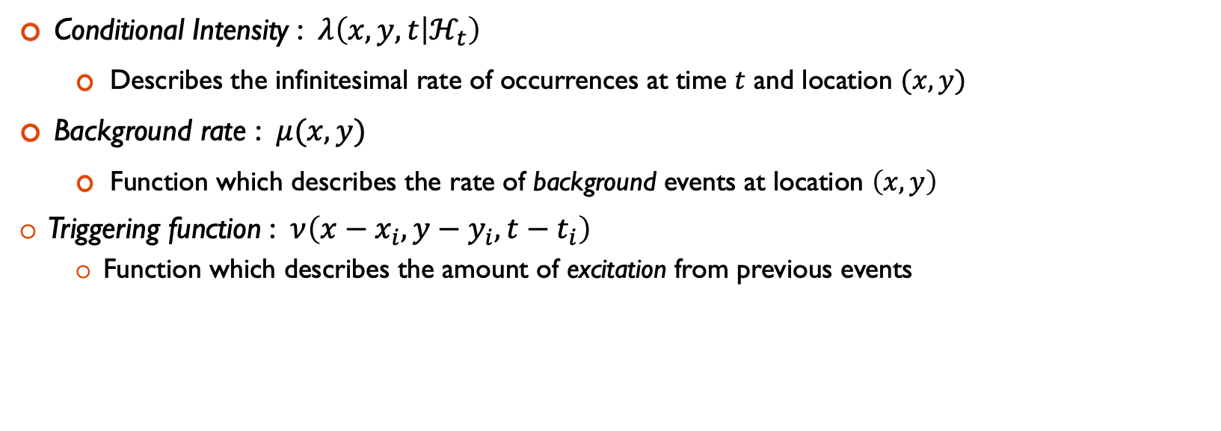
Self-exciting point processes
Conditional Intensity : $λ\left(x,y,t | ℋ_{t}\right)$
Describes the infinitesimal rate of occurrences at time $t$ and location $(x,y)$
Background rate : $μ(x,y)$
Function which describes the rate of background events at location $\left(x,y\right)$
Triggering function : $ν\left(x−x_{i},y−y_{i},t−t_{i}\right)$
Function which describes the amount of excitation from previous events
$$λ\left(x,y,t | ℋ_{t}\right)=μ\left(x,y\right)+\sum_{i:t_{i}<t}{ν\left(x−x_{i},y−y_{i},t−t_{i}\right)}$$
9
Notes:
"Conditional" because we condition on _all_ points up to time t.

Slide 10
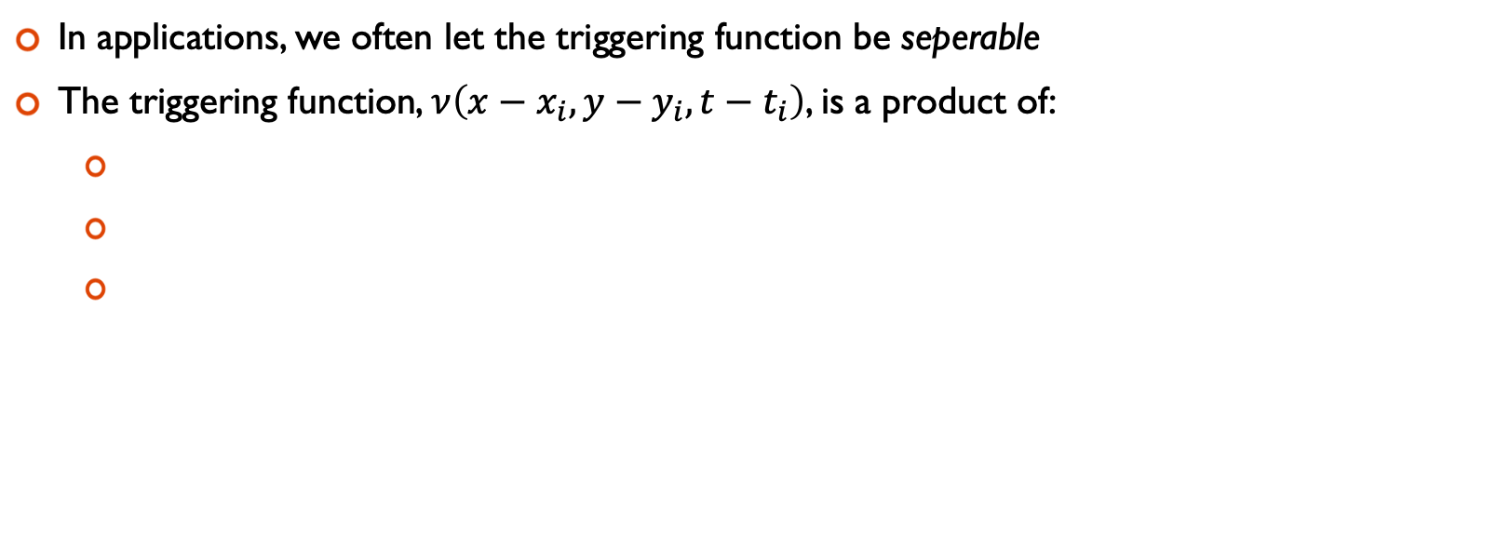
Self-exciting point processes
In applications, we often let the triggering function be seperable
The triggering function, $ν\left(x−x_{i},y−y_{i},t−t_{i}\right)$, is a product of:
$$λ\left(x,y,t | ℋ_{t}\right)=μ\left(x,y\right)+\sum_{i:t_{i}<t}{ν\left(x−x_{i},y−y_{i},t−t_{i}\right)}$$
10

Slide 11

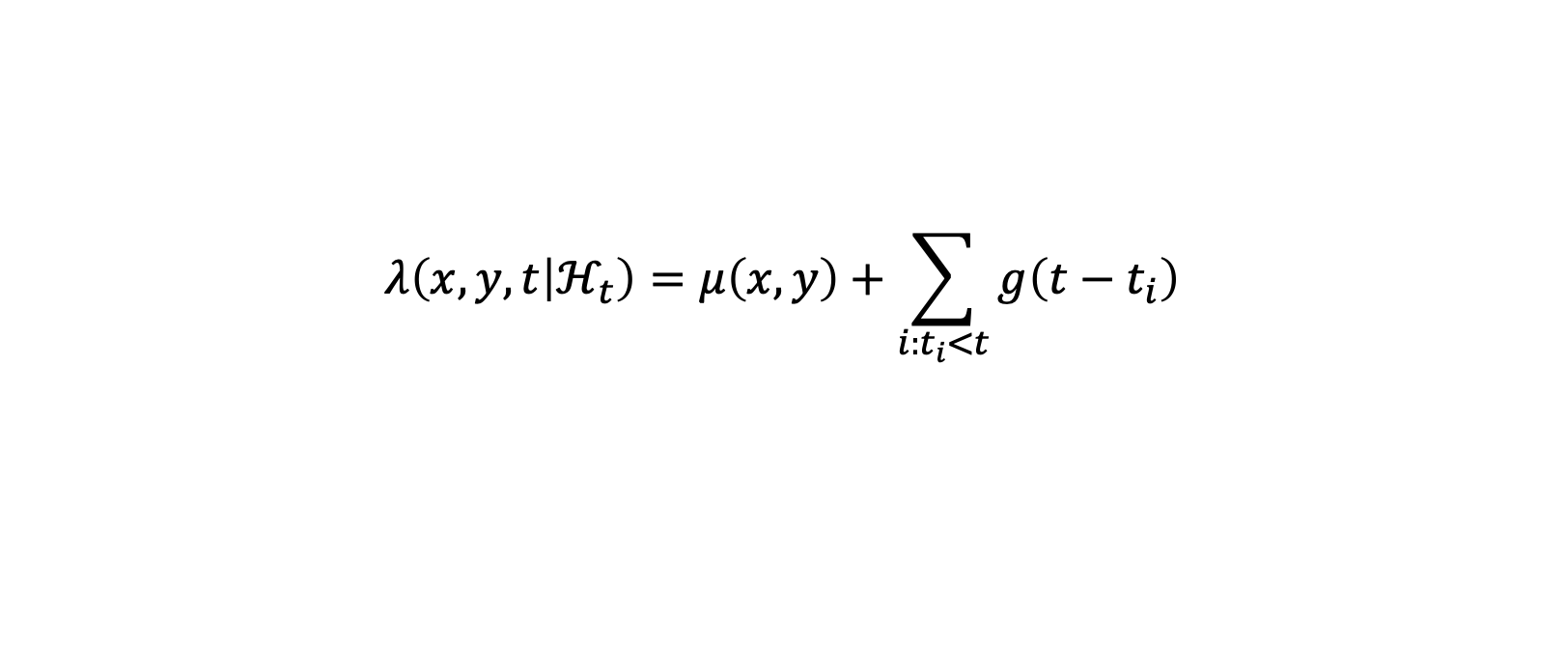
Self-exciting point processes
In applications, we often let the triggering function be seperable
The triggering function, $ν\left(x−x_{i},y−y_{i},t−t_{i}\right)$, is a product of:
Time : $g\left(t−t_{i}\right)$
$$λ\left(x,y,t | ℋ_{t}\right)=μ\left(x,y\right)+\sum_{i:t_{i}<t}{g\left(t−t_{i}\right)}$$
11

Slide 12

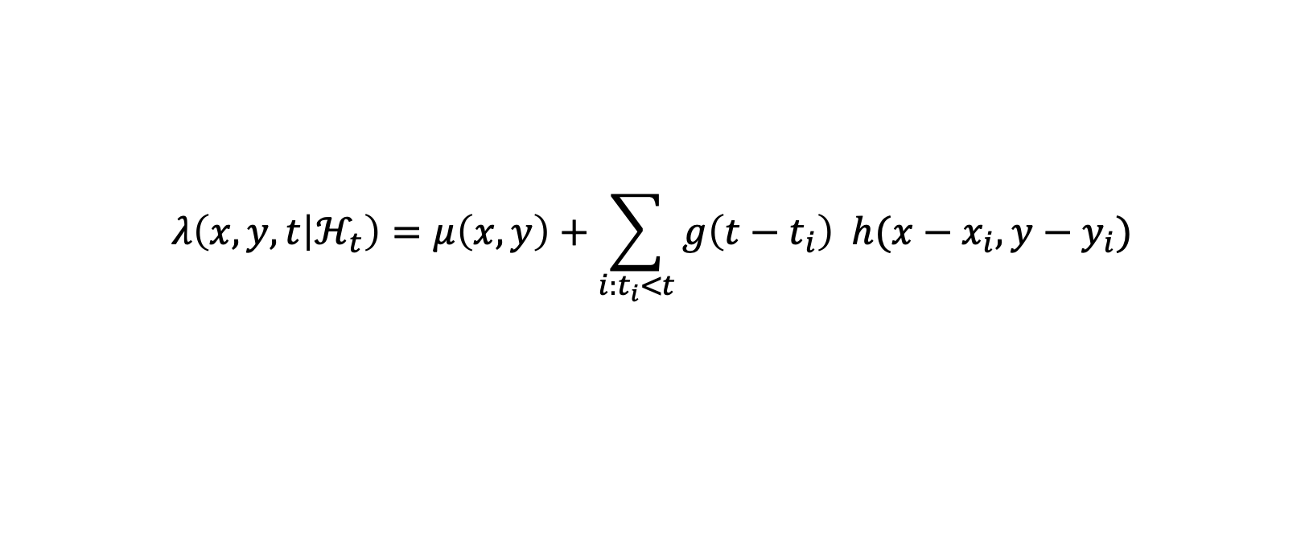
Self-exciting point processes
In applications, we often let the triggering function be seperable
The triggering function, $ν\left(x−x_{i},y−y_{i},t−t_{i}\right)$, is a product of:
Time : $g\left(t−t_{i}\right)$
Space : $h(x−x_{i},y−y_{i})$
$$λ\left(x,y,t | ℋ_{t}\right)=μ\left(x,y\right)+\sum_{i:t_{i}<t}{g\left(t−t_{i}\right) h(x−x_{i},y−y_{i})}$$
12

Slide 13
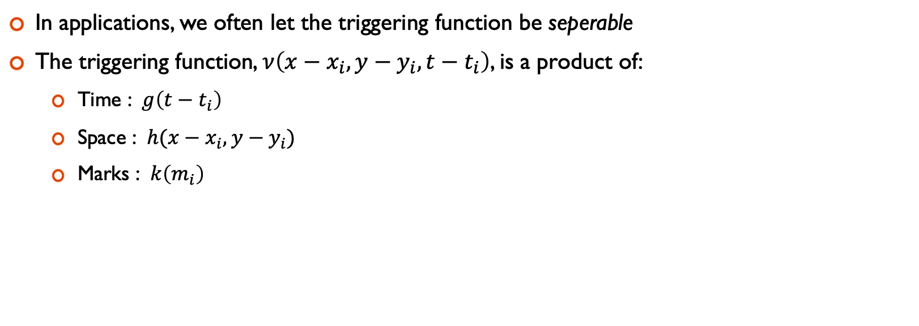
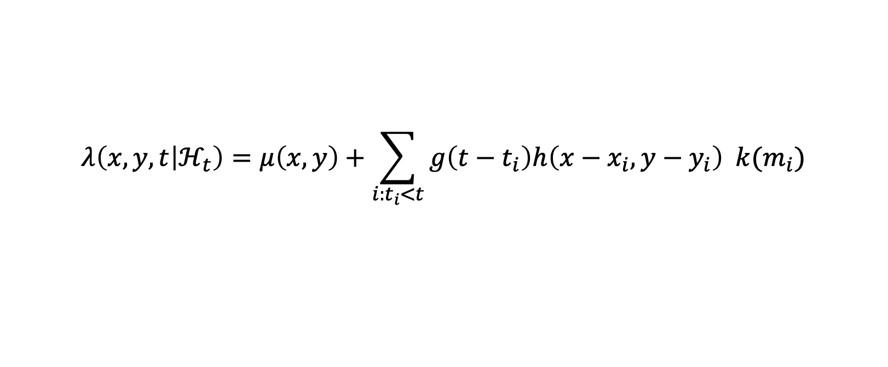
Self-exciting point processes
In applications, we often let the triggering function be seperable
The triggering function, $ν\left(x−x_{i},y−y_{i},t−t_{i}\right)$, is a product of:
Time : $g\left(t−t_{i}\right)$
Space : $h(x−x_{i},y−y_{i})$
Marks : $k\left(m_{i}\right)$
$$λ\left(x,y,t | ℋ_{t}\right)=μ\left(x,y\right)+\sum_{i:t_{i}<t}{g\left(t−t_{i}\right)h\left(x−x_{i},y−y_{i}\right) k(m_{i})}$$
13

Slide 14
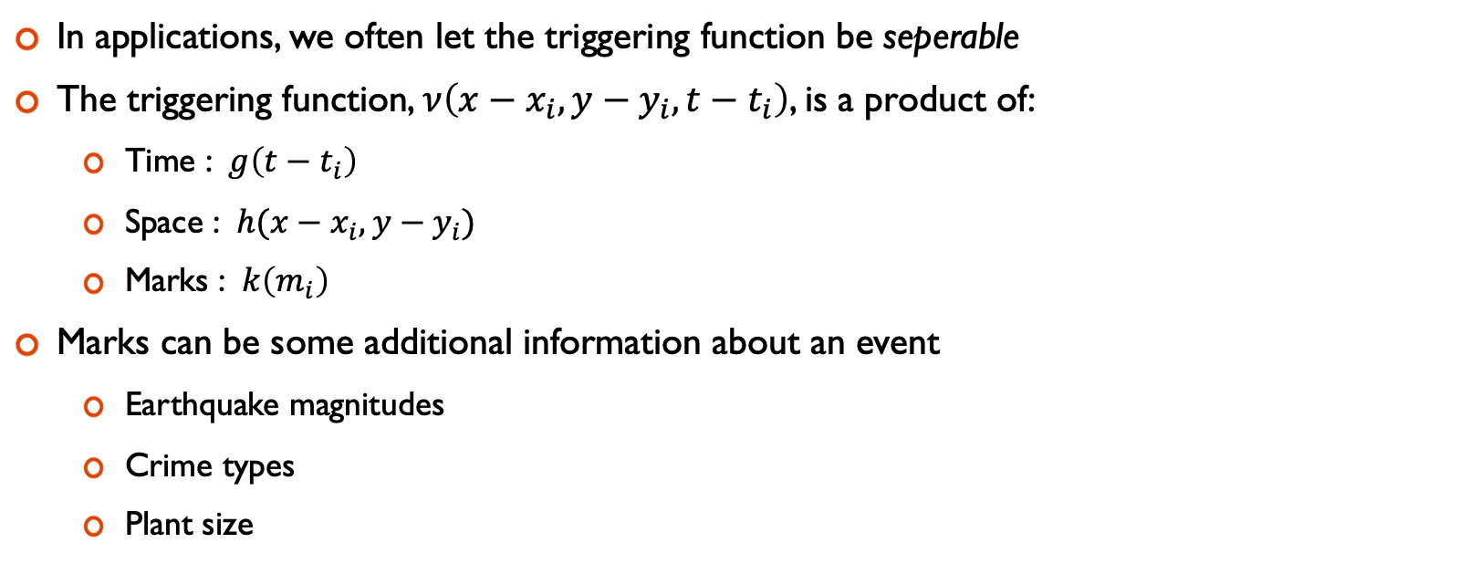
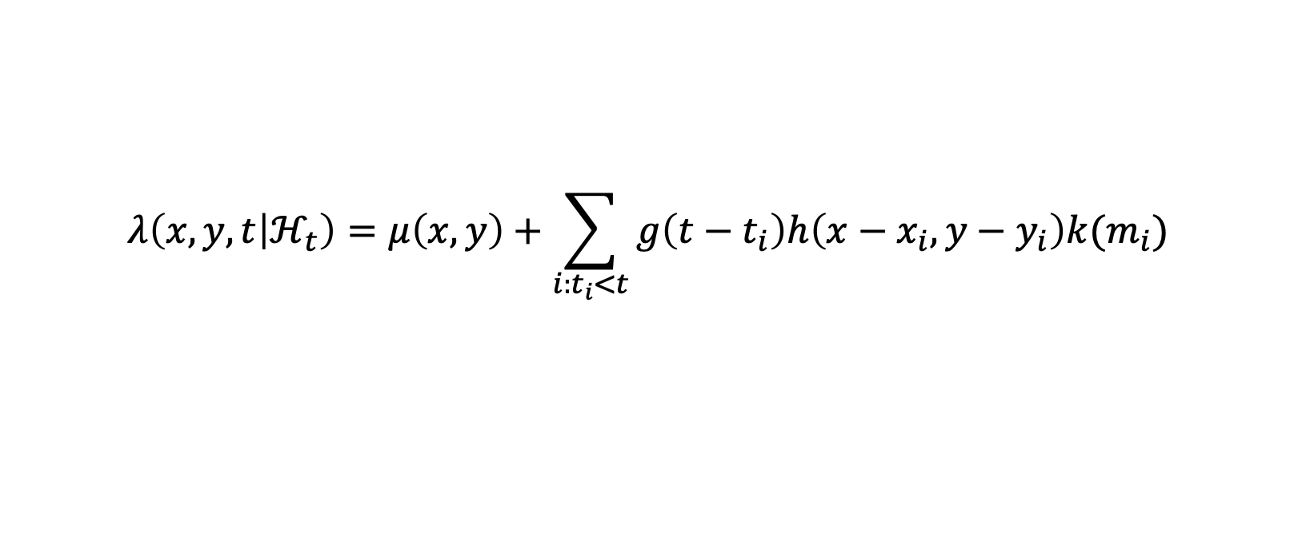
Self-exciting point processes
In applications, we often let the triggering function be seperable
The triggering function, $ν\left(x−x_{i},y−y_{i},t−t_{i}\right)$, is a product of:
Time : $g\left(t−t_{i}\right)$
Space : $h(x−x_{i},y−y_{i})$
Marks : $k\left(m_{i}\right)$
Marks can be some additional information about an event
Earthquake magnitudes
Crime types
Plant size
$$λ\left(x,y,t | ℋ_{t}\right)=μ\left(x,y\right)+\sum_{i:t_{i}<t}{g\left(t−t_{i}\right)h\left(x−x_{i},y−y_{i}\right)k(m_{i})}$$
14

Slide 15
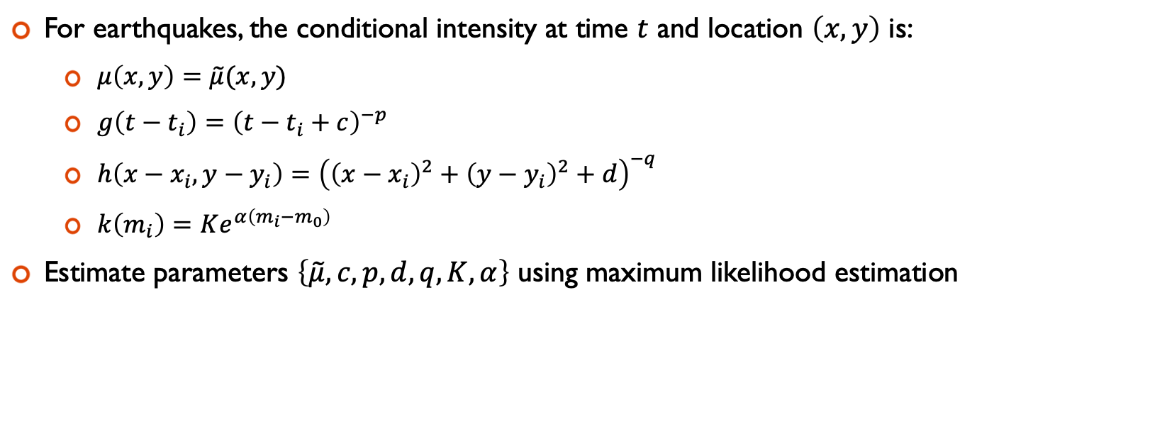
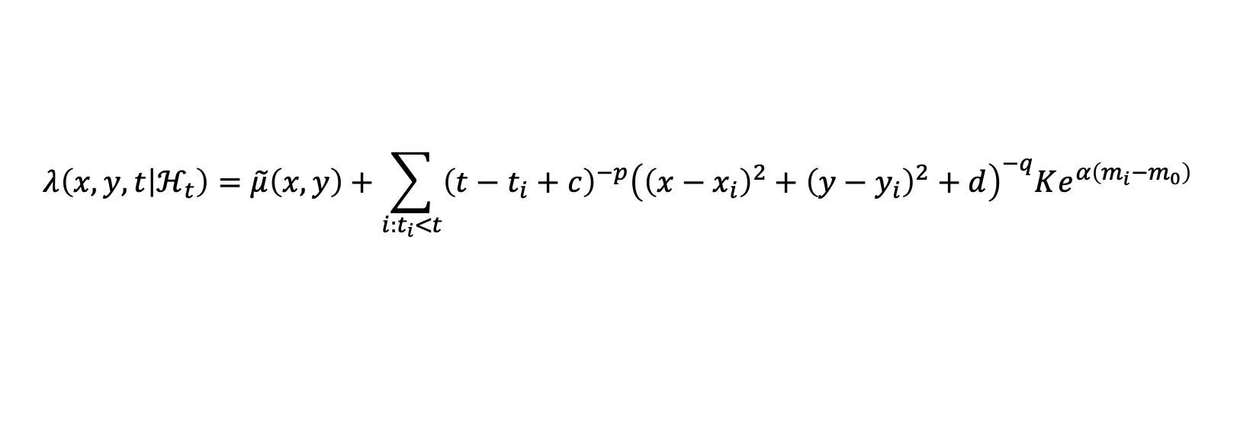
Self-exciting point processes
For earthquakes, the conditional intensity at time $t$ and location $\left(x,y\right)$ is:
$μ\left(x,y\right)=\tilde{μ}(x,y)$
$g\left(t−t_{i}\right)={\left(t−t_{i}+c\right)}^{−p}$
$h\left(x−x_{i},y−y_{i}\right)={\left({\left(x−x_{i}\right)}^{2}+{\left(y−y_{i}\right)}^{2}+d\right)}^{−q}$
$k\left(m_{i}\right)=$ $Ke^{α\left(m_{i}−m_{0}\right)}$
Estimate parameters $\left\{\tilde{μ},c,p,d,q,K,α\right\}$ using maximum likelihood estimation
$$λ\left(x,y,t | ℋ_{t}\right)=\tilde{μ}\left(x,y\right)+\sum_{i:t_{i}<t}{{\left(t−t_{i}+c\right)}^{−p}{\left({\left(x−x_{i}\right)}^{2}+{\left(y−y_{i}\right)}^{2}+d\right)}^{−q}Ke^{α\left(m_{i}−m_{0}\right)}}$$
15

Slide 16
What if we’re unsure we’ve specified our model correctly?
Notes:
Might want to apply self-exciting point processes to a new field of application.
How do we know that power law decay is appropriate? Why not another functional form of decay?

Slide 17
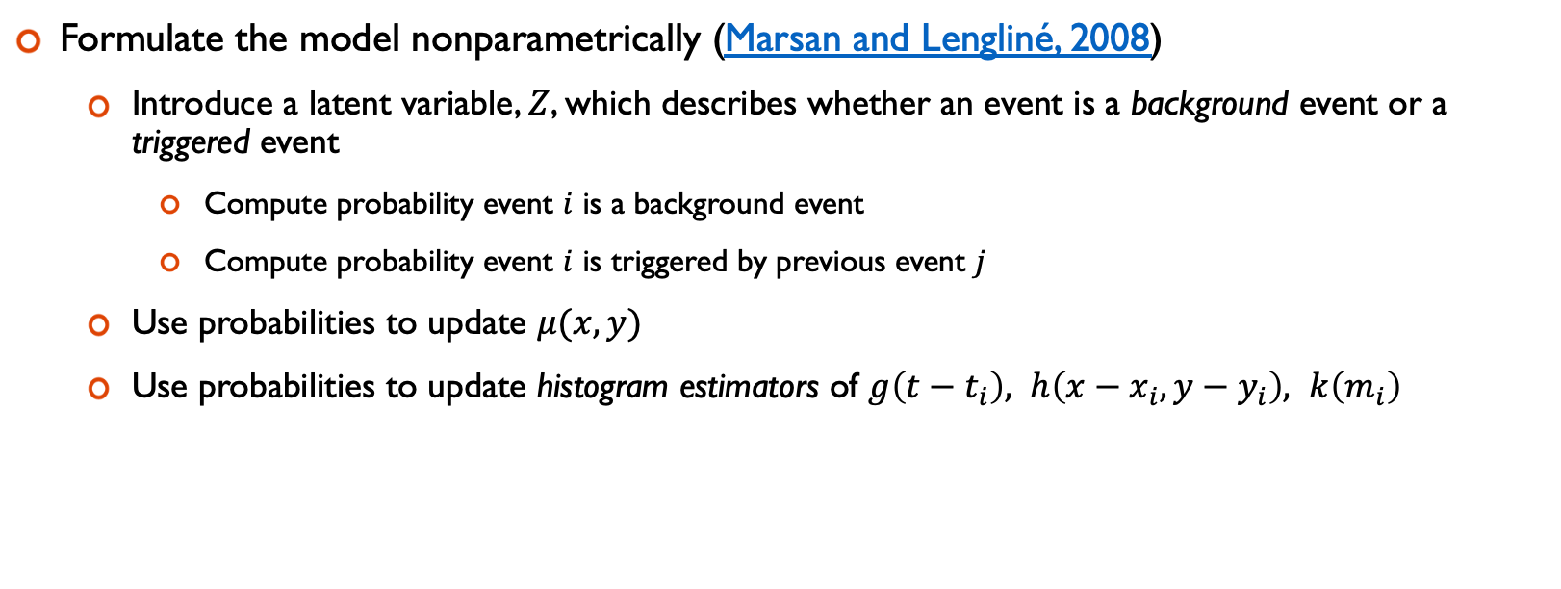
Self-exciting point processes
Formulate the model nonparametrically (Marsan and Lengliné, 2008)
Introduce a latent variable, $Z$, which describes whether an event is a background event or a triggered event
Compute probability event $i$ is a background event
Compute probability event $i$ is triggered by previous event $j$
Use probabilities to update $μ(x,y)$
Use probabilities to update histogram estimators of $g\left(t−t_{i}\right), h\left(x−x_{i},y−y_{i}\right), k\left(m_{i}\right)$
17

Slide 18
Self-exciting point processes
Histogram estimators:
Take domain of pairwise differences of points in time and space
Split the domains into disjoint sets of bins/intervals
Compute step functions (i.e. constant values) for each bin/interval based on the probabilities of points which fall into each bin/interval
Do something similar for the marks
Example:
18

Slide 19
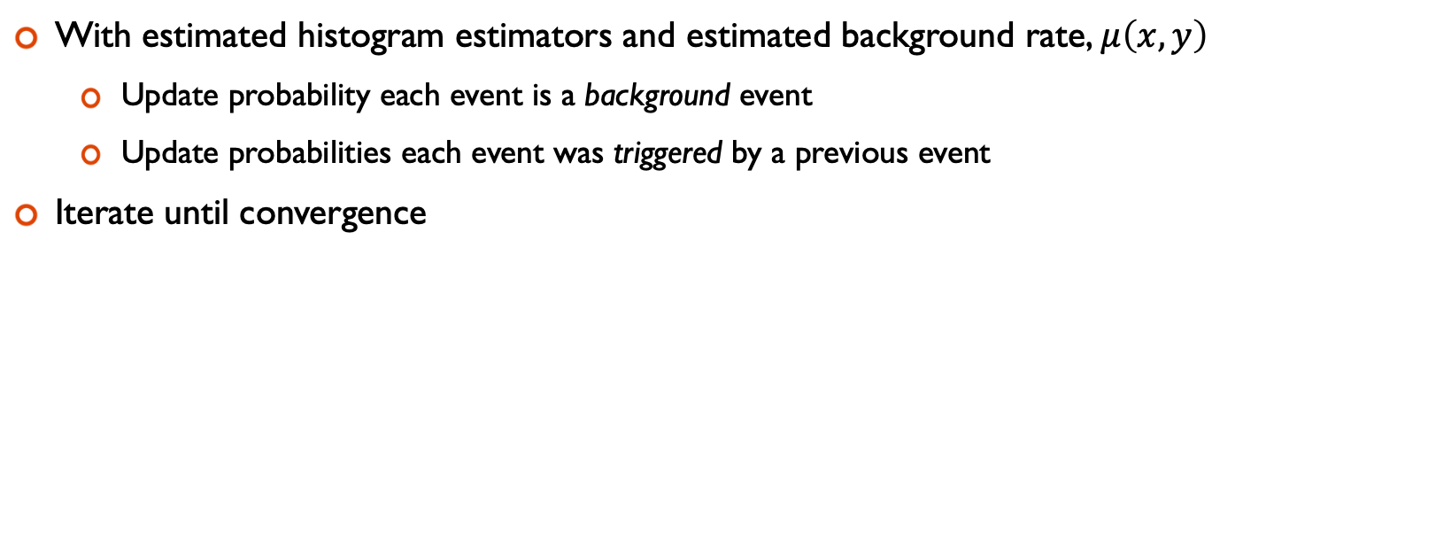
Self-exciting point processes
With estimated histogram estimators and estimated background rate, $μ\left(x,y\right)$
Update probability each event is a background event
Update probabilities each event was triggered by a previous event
Iterate until convergence
19

Slide 20
Recent nonparametric innovations

Slide 21



Recent nonparametric innovations
Peter Boyd, Ph.D. Candidate of Statistics, Oregon State University
Does how we decide to break up the domains of our histogram estimators matter?
Spoiler alert: Yes
Is there some way to resolve this issue which would also let us estimate the triggering functions in a less “clunky” manner?
Spoiler alert: Also yes
: boydpe
: Peter Boyd
21

Slide 22
Recent nonparametric innovations
Rather than specify a set of fixed bins, what if we instead:
Generate lots of random bins of varying size
Use these random bins to estimate the expected rates of triggering which occurs in each bin
Smooth these estimated expected rates to give us a sense of what happens, on average
Benefits:
No longer need for users to specify, and then justify, bins themselves
Random bins of varying sizes give us a better overall sense of the variability of the triggering
Still flexible enough to focus on where we think more/less triggering occurs
22

Slide 23
Application: Hector Mine earthquake sequence

Slide 24
Application: Hector Mine earthquake sequence
Large, magnitude 7.1 earthquake which occurred on October 16, 1999
~50 miles southeast of Barstow, CA
Felt throughout Southern California and Las Vegas
A “fan favorite” for folks in statistical seismology
24
Notes:
Barstow is about ¼ of the way to Las Vegas from Los Angeles.
Home to the original Del Taco

Slide 25
Application: Hector Mine earthquake sequence
25

Slide 26
Closing thoughts

Slide 27
Closing thoughts
Self-exciting point processes are great models for data where points cluster in time or time and space.
Nonparametric methods alleviate need to specify functional forms of temporal/spatial decay.
Recent advances make nonparametric methods less “clunky” to implement/use.
Check out Peter’s Github for:
An R package which implements the histogram estimator version of the model.
Soon: An R package which implements the new method.
Be on the lookout for our article about the new method
27

Slide 28
THANK YOU
: molyneuj@oregonstate.edu
: jimmylovestea
: jimmylovestea

